Slide 1
BUSQOM 1080 Unsupervised Learning II
Fall 2020
Lecture 24
Professor: Michael Hamilton

Slide 2
Lecture Summary
Today: More on Unsupervised Learning
Recap K Means[10 Mins]
Hierarchical approach [20 Mins]

Slide 3
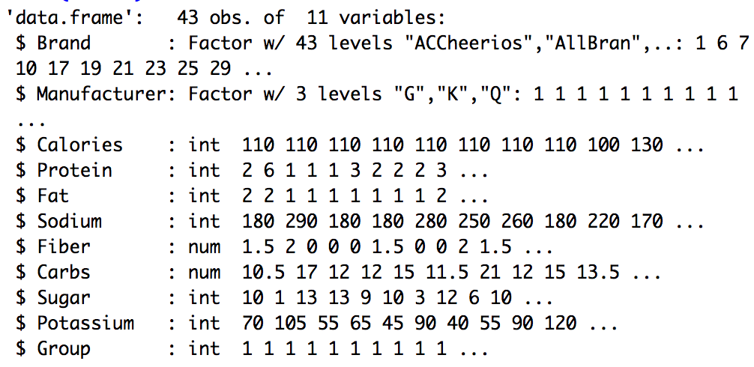
Data for lecture
Cereal dataset
Average review data for 43 breakfast cereals in Europe
cereal = read.table("BreakfastCereals.txt", sep = "\t", header = T)

Slide 4
Recap: Unsupervised Learning
Unsupervised Learning: There are no dependent variables, no class labels.
Data: N observations each with p features X_{1,} X₂ , … X_{N}
Goal: Not interested in prediction, instead we want to discover interesting patterns or subgroups in the data.

Slide 5
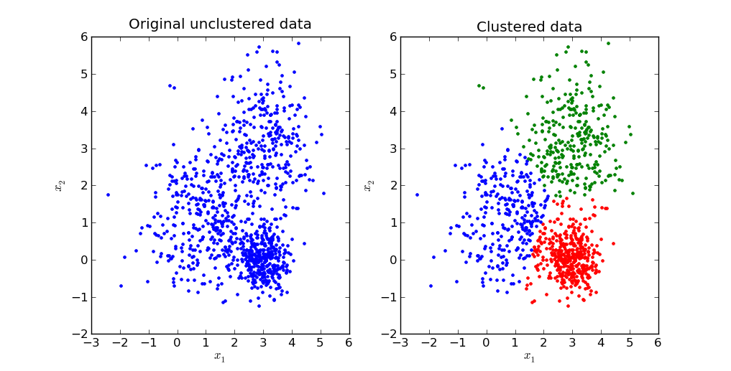

Clustering (Introduction)
Input: A set of N points $X ε R2$ (R^{p} ) and a positive integer k
Objective: Assign each point to a cluster C₁, C₂, …, C_{k}

Slide 6
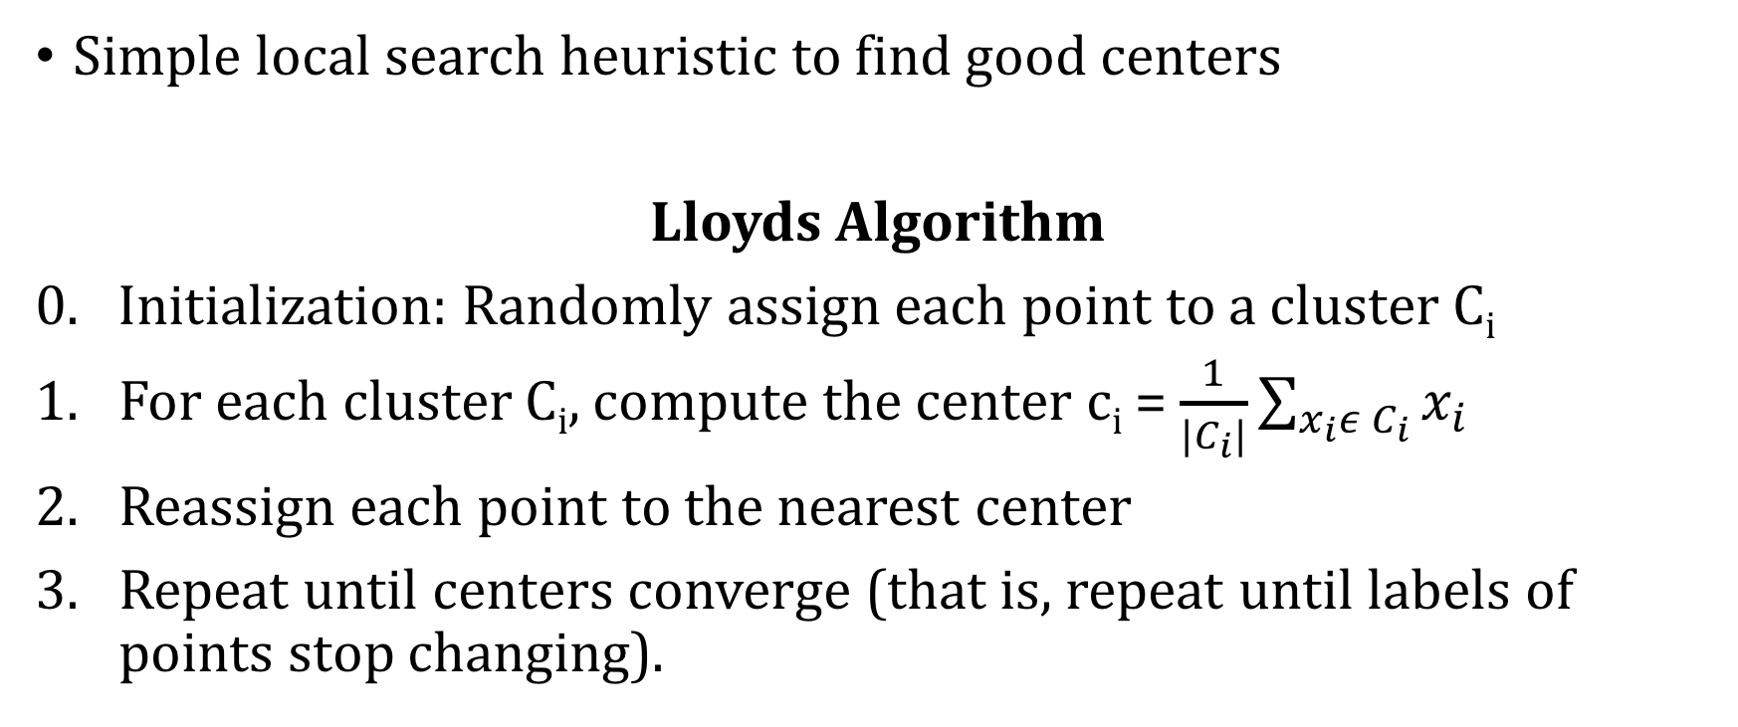
K Means (Lloyds) Algorithm
Simple local search heuristic to find good centers
Lloyds Algorithm
0. Initialization: Randomly assign each point to a cluster C_{i}
For each cluster C_{i}, compute the center c_{i} = $\frac{1}{{|C}_{i}|}\sum_{x_{i}ε C_{i}}{x_{i}}$
Reassign each point to the nearest center
Repeat until centers converge (that is, repeat until labels of points stop changing).

Slide 7
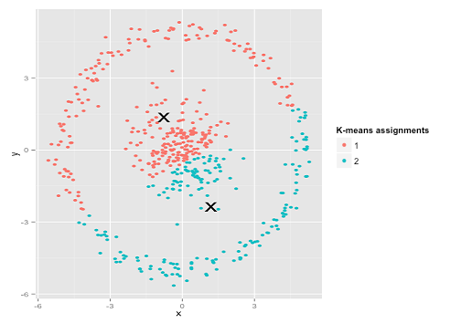
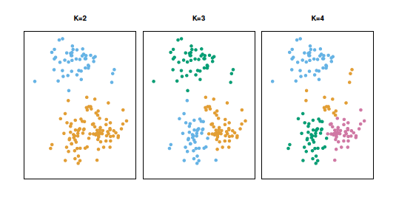
K Means Algorithm
Pros:
Easy to describe and implement
Usually converges quickly
Cons:
No guarantee of solution quality
No guarantee of fast convergence
Bad initializations lead to bad answers
Only finds convex clusters
Need to specify k

Slide 8
Two Types of Clustering Algorithms
Nonhierarchical Methods
Clusters are initially formed based on specified numbers.
Assigns records to each cluster.
Simple and computationally less expensive, so it is the preferred method for very large data sets.
Hierarchical Methods
Agglomerative algorithm begins with N clusters and starts merging sequentially with similar clusters until a single cluster is formed.
Divisive algorithm first starts with one single cluster and then divides into multiple clusters based on dissimilarities.

Slide 9
Hierarchical Clustering Methods
Agglomerative hierarchical methods:
Start with individual objects (as many clusters as objects)
Group most similar objects first
As similarity decreases, all subgroups are merged to form single cluster
Divisive hierarchical methods:
Start with two subgroups (dissimilar)
Divide subgroups further into dissimilar subgroups
Eventually, each object forms its own group
Display results in a dendrogram to illustrate mergers or divisions

Slide 10
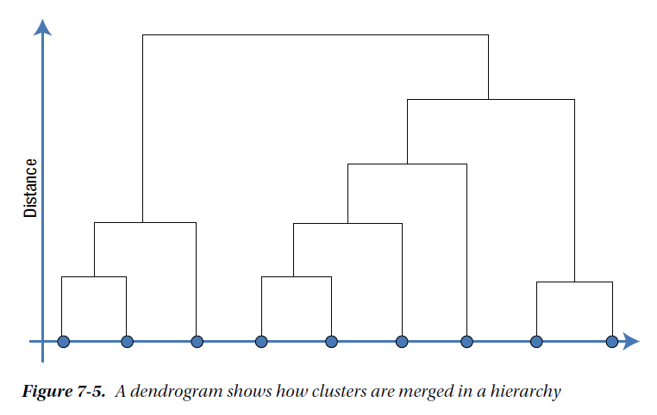
Dendrogram - A way of describing hierarchical clustering
Clustering of size 2
Clustering of size 3
Clustering of size 4
Clustering of size 6
Start: Each point is in its own cluster

Slide 11
Linkage Methods
Single Linkage – distance between 2 clusters defined as the minimum distance between one point from each cluster (nearest neighbor approach)
Complete Linkage – distance between 2 clusters defined as the maximum distance between one point from each cluster (farthest neighbor approach)
Average Linkage – distance between 2 clusters defined as the average of the distances between each point in one cluster to every point in the other cluster
Centroid Linkage – distance between 2 clusters defined as the distance between cluster centroids (average)

Slide 12
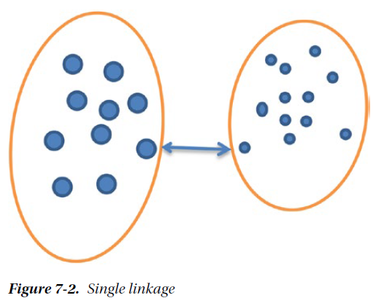
Single Linkage
Single Linkage – distance between 2 clusters defined as the minimum distance between one point from each cluster (nearest neighbor approach)

Slide 13
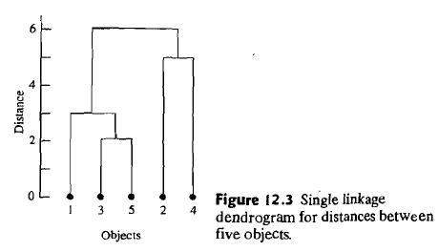
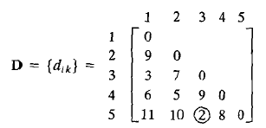
Single Linkage
Start with hypothetical distances between pairs of 5 objects

Slide 14
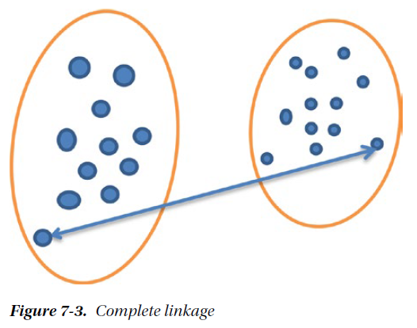
Complete Linkage
Complete Linkage – distance between 2 clusters defined as the maximum distance between one point from each cluster (farthest neighbor approach)

Slide 15
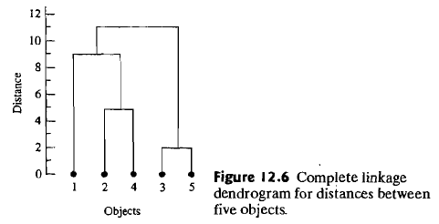
Complete Linkage

Slide 16
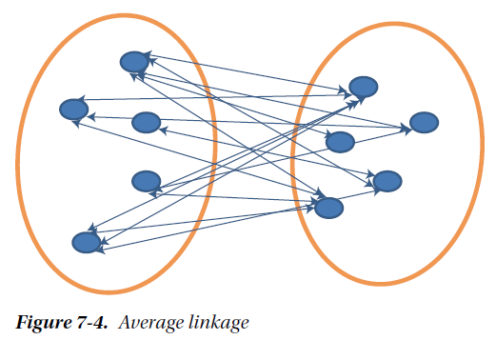
Average Linkage
Average Linkage – distance between 2 clusters defined as the average of the distances between each point in one cluster to every point in the other cluster

Slide 17

Average Linkage
First find most similar objects to form first cluster (UV)
Distances between (UV) and the other cluster W are determined by

Slide 18
Example: Breakfast Cereals
Consider nutritional information for 43 cereals
Can we group cereals based on similar nutritional info?
Step 1: Compute distances between individual observations
Use dist() function
Input variables you want to use for clustering as a matrix
Specify method for computing distance

Slide 19

Example: Single Linkage
Use hclust() function to obtain cluster solutions
Plot result to view dendrogram
Input distance matrix
Specify single linkage method
Use members argument to provide labels for observations

Slide 20
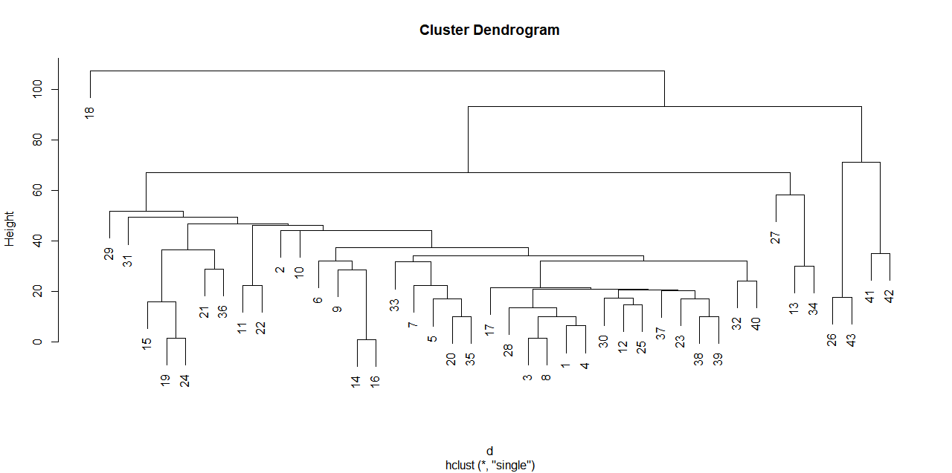

Slide 21
We can make the plot look nicer
Clustering result
Use labels instead of row numbers
Allow labels to hang below 0 on y-axis

Slide 22
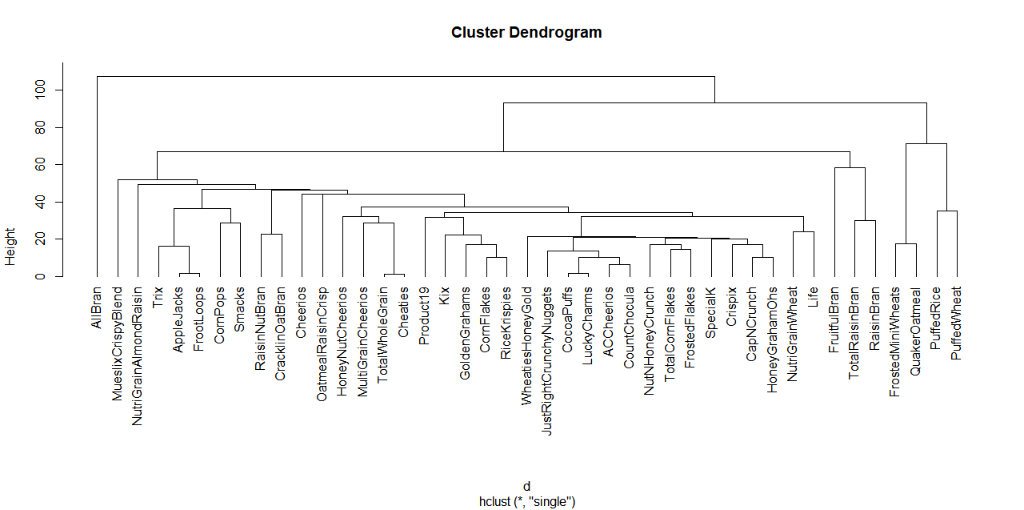

Slide 23
How many clusters should we choose?
install.packages("NbClust")
library(NbClust)
Data to be clustered
Distance method
Specify min and max numbers of clusters to consider
Clustering method

Slide 24
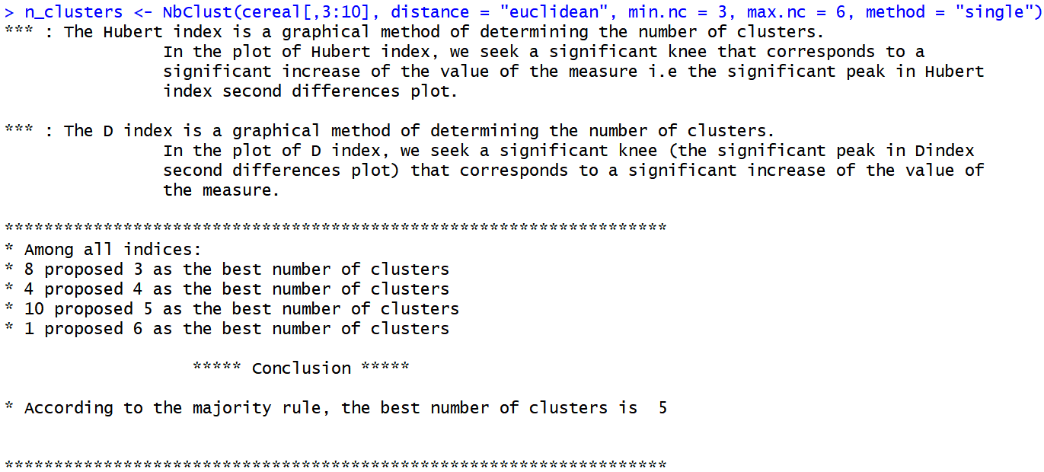
5 Clusters suggested

Slide 25
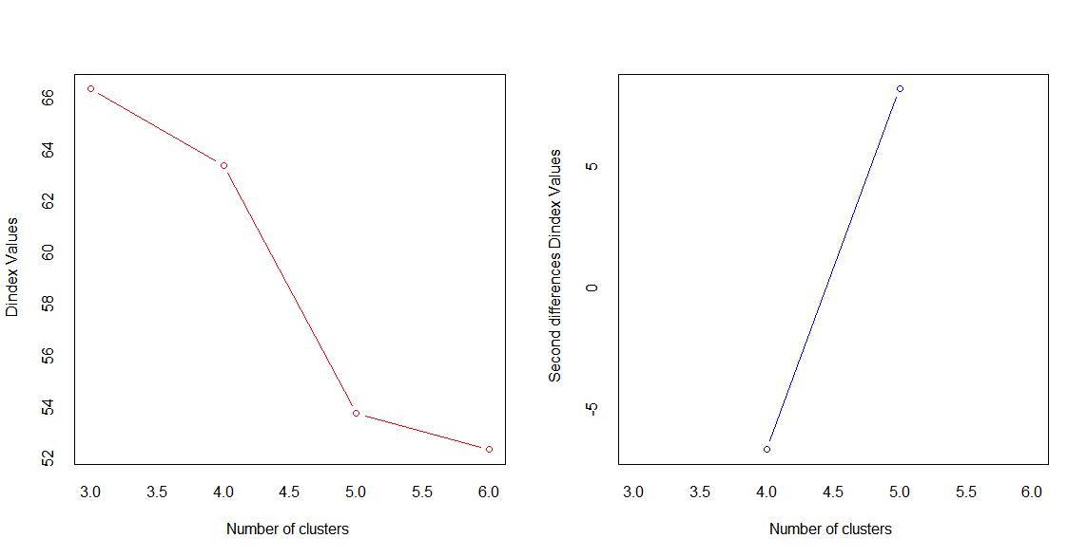
Plots from NbClust()

Slide 26

Let’s visualize 5 clusters on dendogram
Use rect.hclust() function
Previous plot
Clustering result
Number of clusters

Slide 27
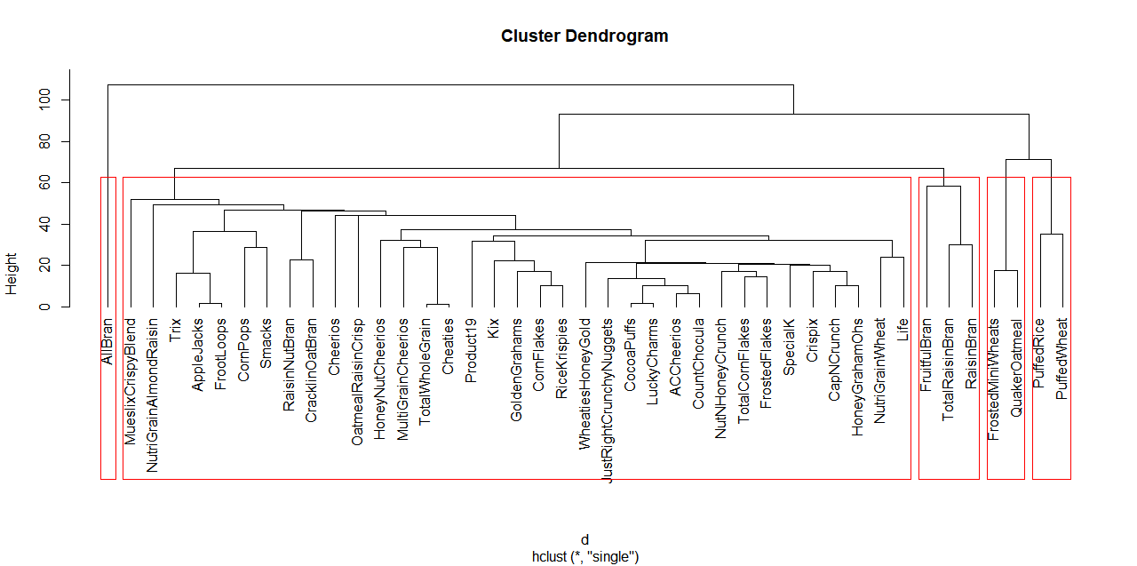

Slide 28
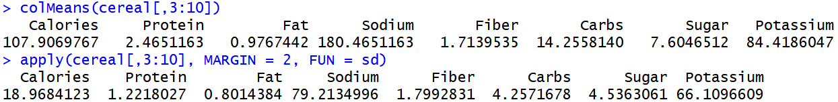
Potential Problem: Scaling
Differences in scales of variables means some variables carry more weight i.e. closeness in one variable is more important than another
Easy to fix though, just by standardizing the data first

Slide 29
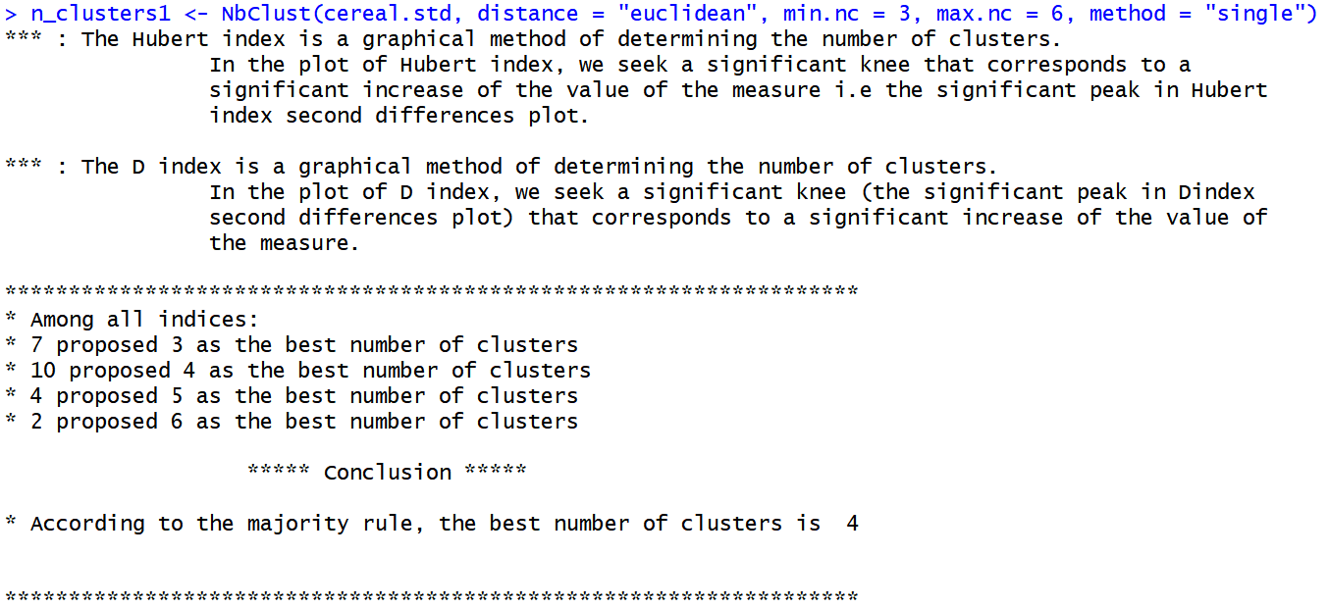
Clustering with Standardized Data

Slide 30
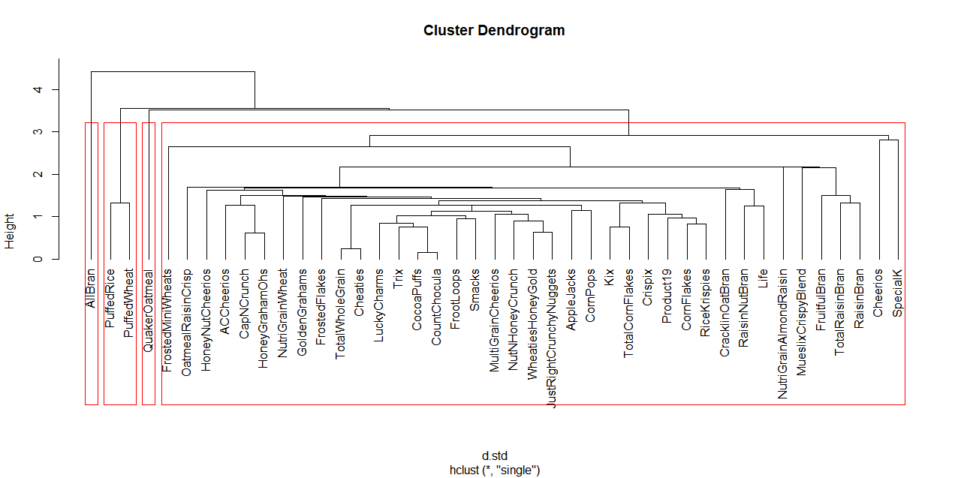

Slide 31
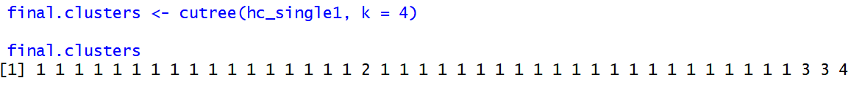
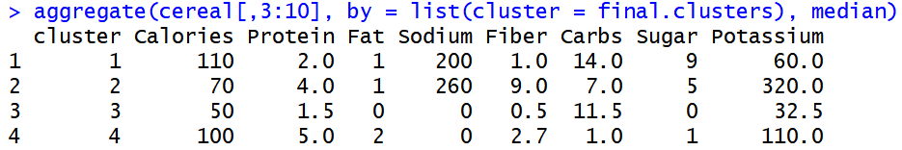
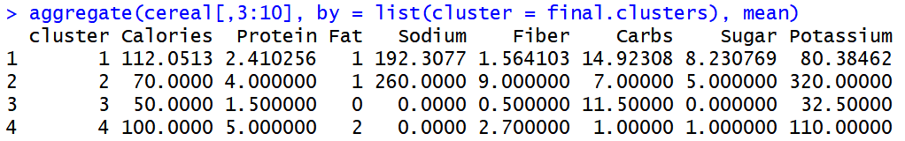
Final Clusters
Use cutree() function:
Aggregate data based on final clusters
Clustering result
Number of clusters

Slide 32
How do other hierarchical methods compare?
Complete Linkage: 4 clusters
Same number but different clusters than single linkage
Average Linkage: 6 clusters
Largest cluster from single linkage split into 3 groups
Centroid Linkage: 4 clusters
In this case, same result as single linkage (not always)

